Slide 1


Medical Lie Detector: ClinIQ
Project presentation
Natural Language Processing with Large Language Models
Lorena Raichle, Adria Pop, Konstantin Wehmeyer
May 20, 2025

Slide 2

Have you ever googled your symptoms?
Notes:
-So we all know this feeling and know how inaccurate some medical information may be whether it be Chatgpt or a quick google search
-Both our project and the initial challenge have took on the task to solve this huge problem.

Slide 3

This is the task of the ClinIQ 2025 Lie Detector Test
Key Information
Evaluate the ability of generative models to produce factually accurate medical information
Challenge by the University of Maryland
4 different question types were proposed
No datasets were provided
Evaluation metrices were suggested
Notes:
-Lie Detector that evaluates how well generative AI models can produce factually accurate medical information
-how accurately retrieve and generate medical knowledge
-procedures, conditions, diagnostics, and drugs
-Scoring is based only on factual accuracy
-Answers must match exactly or be semantically equivalent.

Slide 4

Agenda
1
Introduction of the ClinIQ challenge
@Adria bild ersetzen
2
Our approach to solve the challenge
3
Data gathered for training and testing
4
Scores leveraged for evaluation
Agenda
5
Models + Results for our different approaches
Baseline Fine-Tuning (FT)
Retrieval Augmented Generation (RAG)
FT + RAG
6
Final remarks and next steps

Slide 5
4 different question types were provided
Multiple Choice (MC)
True/ False (TF)
Short Answer (SA)
Multi
Hop
(MH)
{"correct_answer": "A",
"options": {
"A": "Localized immune complex",
"B": "Ag- Ab reaction",
"C": "Complement mediated",
"D": "Ab mediated"},
"question": "Ahus reaction is…",
"source": "MC4-UCSC-VLAA/MedReason",
"type": "multiple_choice"}
{"answer": "True",
"question": "Is reduced Klotho associated with the presence …?",
"source": "TF2-qiaojin/PubMedQA",
"type": "true_false"}
{"question": "What is the value of …?",
"answer": "In the late distal tubule, [TF/P]osm is less than 1 when there is low ADH.",
"source": "SA2-Ajayaadhi/Medical-QA",
"type": "short_answer"}
{"question": "In a study assessing …?",
"answer": "In a normal...",
"reasoning": [
"Step 1: Alright, ...",
"Step 2: When a student’s...",
"Step 3: I remember from stats that ...",…],
"source": "MH-FreedomIntelligence/medical-o1-reasoning-SFT",
"type": "multi_hop"}
Notes:
Q&A system that specialized on each of the following question types
Tagged entries with origin dataset and type
No inverse QUESTIONS in the dataset
For the MH: reasoning steps CoT dataset that we split into steps
Data augmentation not needed: Synthetic generation, paraphrasing was not needed in our opinion

Slide 6
We used a four-lane approach with a mix of separate and combined steps
Challenge
ClinIQ
Question Type
MC
TF
SA
MH
Data Collection
Pre- processing
One consolidated train-test set
Model predictions
Baseline
FT
RAG
RAG + FT
Evaluation
Discrete Evaluation
Text Evaluation

Slide 7
1
Introduction of the ClinIQ challenge
2
Our approach to solve the challenge
3
Data gathered for training and testing
4
Scores leveraged for evaluation
Agenda
5
Models + Results for our different approaches
Baseline Fine-Tuning (FT)
Retrieval Augmented Generation (RAG)
FT + RAG
6
Final remarks and next steps

Slide 8
More than 500k questions were gathered across 9 different datasets with different layouts
Details
515.876
questions across
9
different datasets
217.327
questions across
4 MC datasets
67.576
questions across
3 SA datasets
211.269
questions in
1 TF dataset
19.704
questions in
1 MH dataset
PubMed Research articles as additional data
2.209.839
rows of articles
Notes:
TRAIN TEST

Slide 9
We identified two problems within our datasets: TF imbalance and too many MC questions
Dataset cleaning process
Consolidated dataset
Balanced TF dataset
Reduced MC dataset
174
169
174
70% of TF were true
Now we had too many MC questions
70
54
54
54
43
42
43
24
20
24
14
16
14
16
14
16
4
6
4
6
4
MC
TF
SA
MH
MC
TF
SA
MH
MC
TF
SA
MH
Train
Test
Notes:
Stratified split by “type” to have for each question type equal as many in train/test.
Train test split of 80/20
Learn to always predict the majority class
Appear to perform well on accuracy, but fail in real-world settings or on the minority class ("False")
The model may learn to prefer patterns from multiple choice
fail to generalize across question types, especially if different skills required
For the MC in the RAG we performed additional cleaning “All of the above”

Slide 10
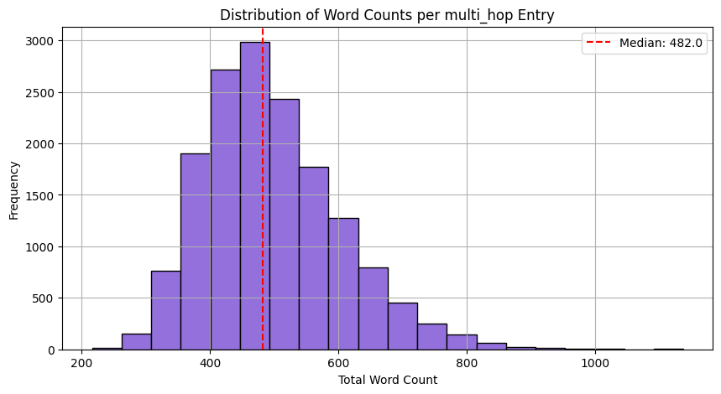
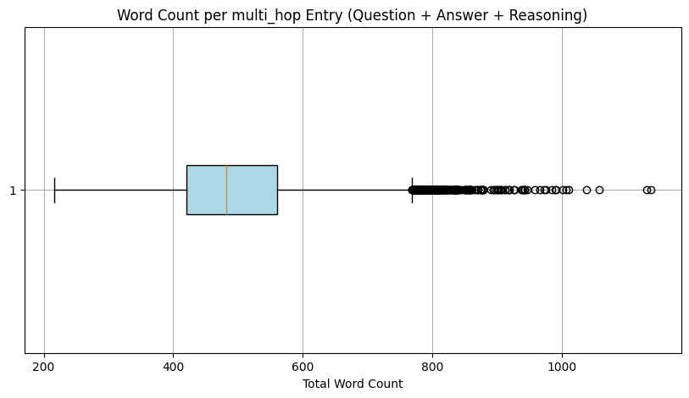
Preprocessing – Train and Test
Reasoning Steps For Multi Hop
Min: 216, Max: 1138, Median: 482.0, Mean: 496.60
Notes:
At first, we wanted to work with a large amount of reasoning data (10 individual datasets)
Our idea was to let a teacher model codellama/CodeLlama-7b-Instruct-hf generate reasoning steps ≈ Distillation
We decided to get a smaller dataset that would ensure higher quality for our model to learn reasoning
Divided the CoT into steps

Slide 11
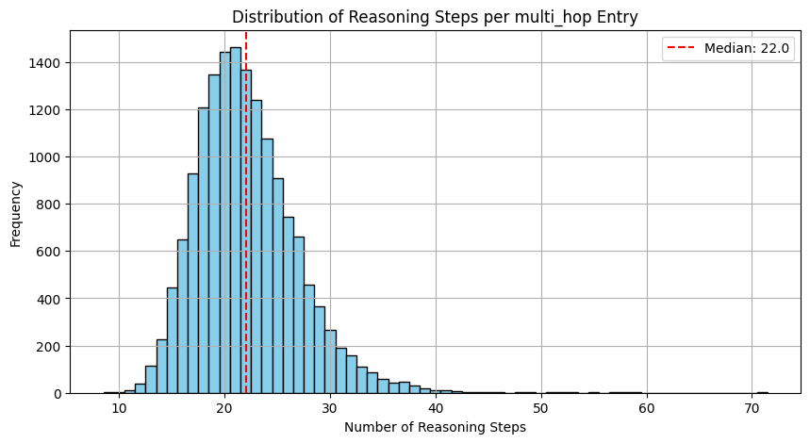
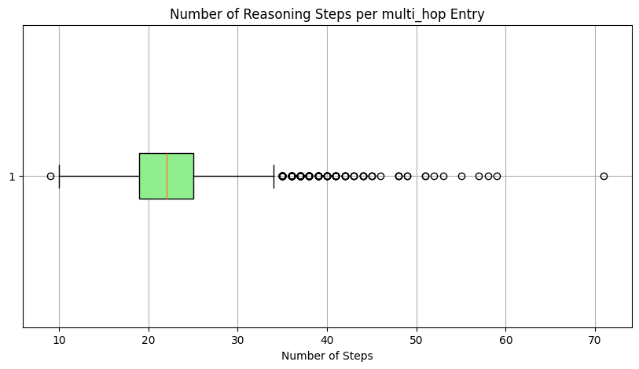
Preprocessing – Train and Test
Reasoning Steps For Multi Hop
Min: 9, Max: 71, Median: 22.0, Mean: 22.08
Notes:
At first, we wanted to work with a large amount of reasoning data (10 individual datasets)
Our idea was to let codellama/CodeLlama-7b-Instruct-hf generate reasoning steps ≈ Distillation
We decided to get a smaller dataset that would ensure higher quality for our model to learn reasoning

Slide 12
More than 500k questions were gathered across 9 different datasets with different layouts
Details
515.876
questions across
9
different datasets
217.327
questions across
4 MC datasets
67.576
questions across
3 SA datasets
211.269
questions in
1 TF dataset
19.704
questions in
1 MH dataset
PubMed Research articles as additional data
2.209.839
rows of articles
Notes:
-The PubMed data more on the technical side

Slide 13

Preprocessing – PubMed Articles
Enhancing The Database with Knowledge
MedRAG/pubmed
Title
Content (=Abstract)
Contents
Used as additional medical expert knowledge in the RAG database
{“id": "pubmed23n0001_0",
“title": "Biochemical studies on camomile ...",
“content": "alpha-Bisabolol has a primary antipeptic action depending on dosage, which is not caused by an alteration of the pH-value. The proteolytic activity of pepsin is reduced by 50 percent through addition of bisabolol in the ratio of 1/0.5….",
“contents": "Biochemical studies on camomile components/III. In vitro studies about the antipeptic activity of (--)-alpha-bisabolol (author's transl)]. (--)-alpha-Bisabolol has a primary antipeptic action depending on dosage, which is not caused by an alteration of the pH-value."}
Notes:
-enriching ability to reason across underrepresented question types

Slide 14

Agenda
1
Introduction of the ClinIQ challenge
@Adria bild ersetzen
2
Our approach to solve the challenge
3
Data gathered for training and testing
4
Scores leveraged for evaluation
Agenda
5
Agenda
Models + Results for our different approaches
Baseline Fine-Tuning (FT)
Retrieval Augmented Generation (RAG)
FT + RAG
6
Final remarks and next steps

Slide 15
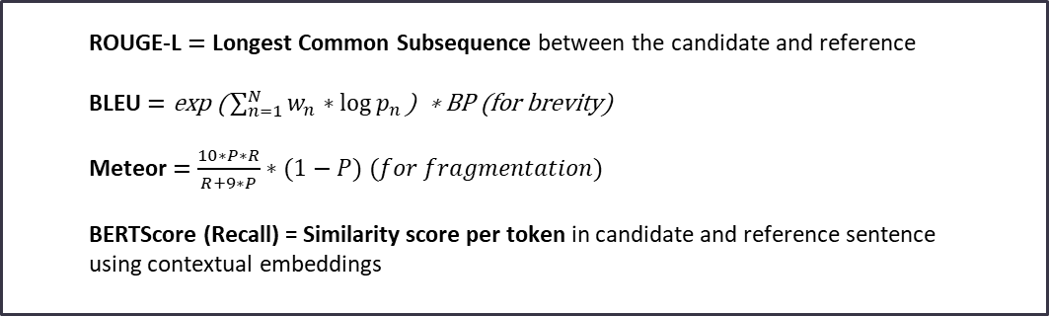
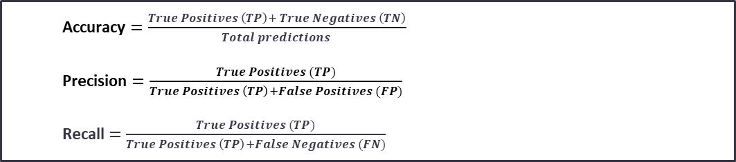
We used standard metrices to evaluate discrete and text answers, mainly Accuracy and ROUGE-L
Discrete evaluation
(MC, TF)
[2]
Accuracy $=\frac{True Positives \left(TP\right)+ True Negatives \left(TN\right)}{Total predictions }$
Precision $=\frac{True Positives (TP)}{True Positives \left(TP\right)+False Positives (FP)}$
Recall$=\frac{True Positives (TP)}{True Positives \left(TP\right)+False Negatives (FN)}$
Text evaluation (SA, MH)
[2][5][6]
ROUGE-L$=\text{Longest} \text{Common} \text{Subsequence} \text{between} \text{the} \text{candidate} \text{and} \text{reference}$
BLEU $=\text{exp}\text{ (}\sum_{n=1}^{N}{w_{n}∗\log{p_{n}}}\text{) ∗ }\text{BP}\text{ (}\text{for} \text{brevity}\text{)}$
Meteor$=\frac{10∗P∗R}{R+9∗P}∗(1−P) (for fragmentation)$
BERTScore (Recall) = Similarity score per token in candidate and reference sentence using contextual embeddings
Notes:
Rougel: Longest common sequence, similarity sentence level, no paraphrasing
BLEU: n-gram overlap, brevity penalty,wording sensitive, no paraphrasing
METEOR:better than BLEU ->semantic flexbiblity
Match on- synonym/stems&paraphrasing
Pentalty word order mismatch
BertScore: (similarity textual embeddings)paraphrase robust
Unlike precision/recall over n-grams (like ROUGE-1 or ROUGE-2), ROUGE-L captures sequence-level structure.
The BLEU score (short for Bilingual Evaluation Understudy) is a widely used automatic evaluation
based on n-gram overlap.
Penalizes overly short outputs that might match reference n-grams but are incomplete.
Pn​=precision of n-gram, w_n weights
Meteor addresses some of the weaknesses of BLEU
Try to find the best one-to-one mapping between words in the candidate and reference.
Matching is based on:
Exact matches
Stem matches (e.g., “run” vs “running”)
Synonym matches (e.g., “boy” vs “kid” via WordNet)
(Optionally) Paraphrase matches
BERTScore evaluates the semantic similarity between a candidate sentence and a reference sentence using contextual embeddings from transformer models like BERT,
Recall: how much of the reference is captured by the candidate

Slide 16
BLEU, ROUGE-L, Meteor and Recall were tested to understand how each score behaves in practice
We tested the scores on non-medical samples…
The capital of France is Paris. It is known for its art, fashion, and culture. The Eiffel Tower is one …
Paris is the capital city of France. It is famous for its museums and historical sites. Tourists often visit
Paris is basically France’s HQ for croissants and kissing. It’s where fashion and romance collide. Eiffel…
A group of flamingos is called a flamboyance. They get their color from eating shrimp. Flamingos…
… and verified the working of our evaluation functions
BLEU
ROUGE-L
Meteor
Recall

Slide 17
We used a four-lane approach with a mix of separate and combined steps
Challenge
ClinIQ
Question Type
MC
TF
SA
MH
Data Collection
Pre- processing
One consolidated train-test set
Model predictions
Baseline
FT
RAG
RAG + FT
Evaluation
Discrete Evaluation
Text Evaluation

Slide 18
With these metrics we can evaluate all question types and approaches separately
Overview of performances per question type and approach
Baseline
FT
RAG
RAG + FT
MC
xx%
Accuracy, Precision, Recall
xx%
xx%
xx%
TF
xx%
xx%
xx%
xx%
SA
Bleu, Meteor, Rouge, Cosine Similarity, BERT scores
xx.x
xx.x
xx.x
xx.x
MH
xx.x
xx.x
xx.x
xx.x

Slide 19
Agenda
1
Introduction of the ClinIQ challenge
@Adria bild ersetzen
2
Our approach to solve the challenge
3
Data gathered for training and testing
4
Scores leveraged for evaluation
Agenda
5
Agenda
Models + Results for our different approaches
Baseline Fine-Tuning (FT)
Retrieval Augmented Generation (RAG)
FT + RAG
6
Final remarks and next steps

Slide 20
With these metrics we can evaluate all question types and approaches separately
Overview of performances per question type and approach
Baseline
FT
RAG
RAG + FT
MC
1,000
Acc: 0.254
Acc: 0.404
Acc: 0.337
Acc: 0.467
TF
1,000
Acc: 0.477
Acc: 0.655
Acc: 0.437
Acc: 0.595
SA
500
ROUGE-L: 0.06
ROUGE-L: 0.18
ROUGE-L: 0.26
ROUGE-L: 0.35
MH
500
ROUGE-L: 0.07
ROUGE-L: 0.24
ROUGE-L: 0.29
ROUGE-L: 0.40
Number of test questions
Notes:
FT vs RAG – discrete vs text

Slide 21
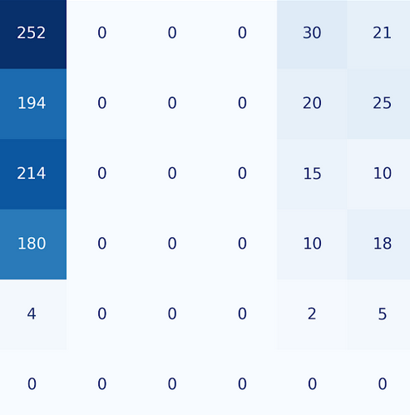
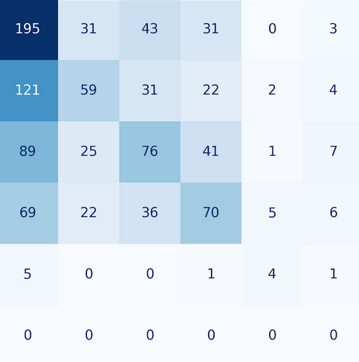
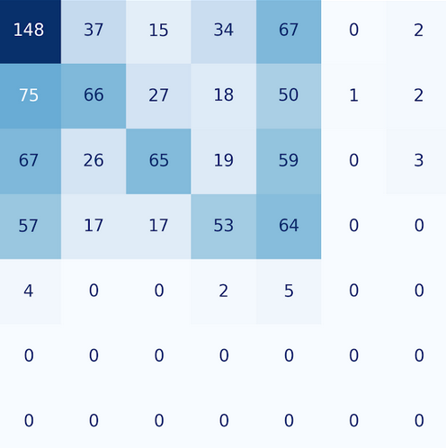
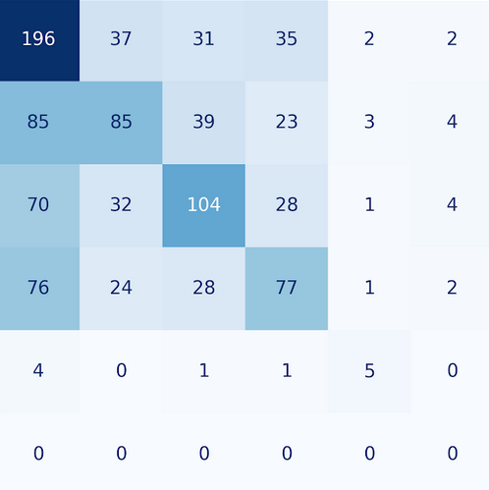
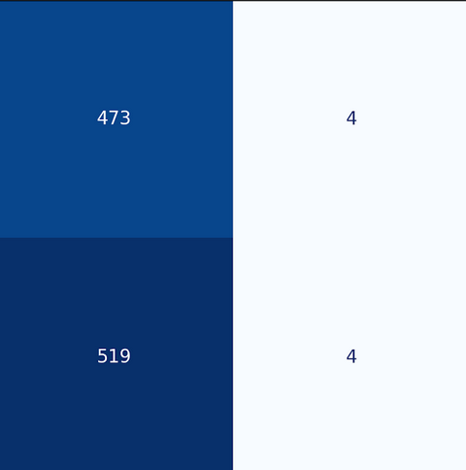
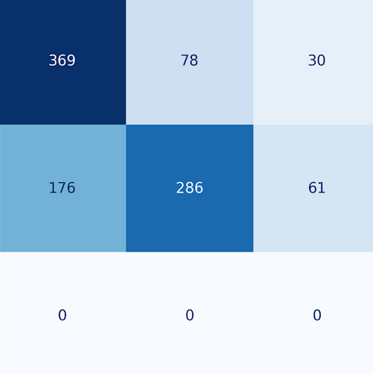
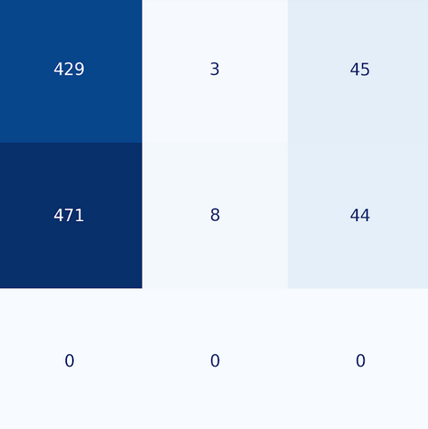
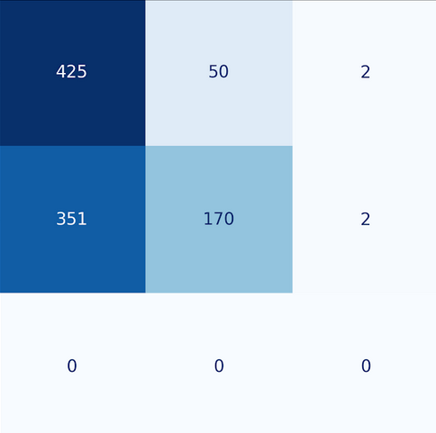
With these metrics we can evaluate all question types and approaches separately
Overview of performances per question type and approach
Baseline
FT
RAG
RAG + FT
MC
TF

Slide 22
With these metrics we can evaluate all question types and approaches separately
Overview of performances per question type and approach
Baseline
FT
RAG
RAG + FT
SA
MH
BLEU
ROUGE-L
Meteor
Recall
Notes:
BLEU n-gram überlappung
Meteor:
BLEU

Slide 23
A DeepSeek coder instruct model was used as a pretrained base model
Baseline
FT
RAG
RAG + FT
Architecture Insights
Model used
Prompts used
Name: /deepseek-coder-7b-instruct-v1.5
Programming focused next token prediction
Continued pre-training from Deepseek-LLM 7B
2T tokens with a window size of 4K
Instruction data of 2B used for fine-tuning
Short prompts were listed as best practice
No extensive prompt engineering was conducted
pipe(testset[i]['prompt'],
max_new_tokens= 20, 20, 100, 200
temperature= 0.1, 0.1, 0.7, 0.7
top_p=0.9,
top_k=50,
do_sample=True
)
MC
TF
SA
MH

Slide 24
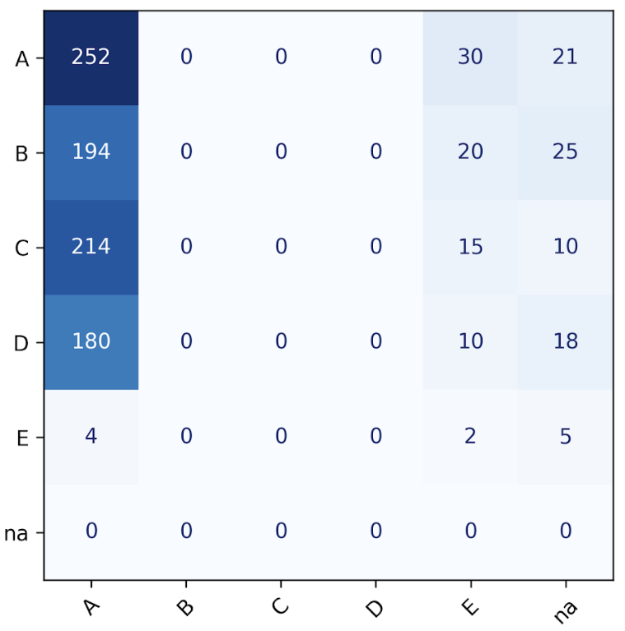
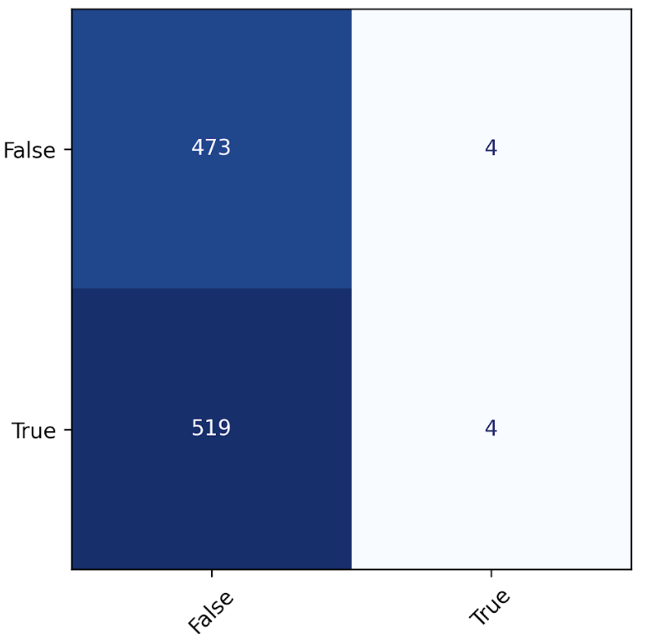
The DeepSeek base model was not equipped to answer medical questions and blocked many
Baseline
FT
RAG
RAG + FT
Research Insights
Consistent "guesses" for the discrete questions…
…and blocked answers for the text questions
MC
TF
MH
Answered
Blocked
TF
True label
True label
"As an AI developed by OpenAI, I don't have the capability to provide medical advice or information…"
Predicted label
Predicted label
More than >100x answers with "training by OpenAI"

Slide 25
We used parameter efficient fine-tuning to train almost 4 million parameter in the base model
Baseline
FT
RAG
RAG + FT
Architecture Insights
LoRA fine tuning parameters
Labels used for fine-tuning
lora_config = LoraConfig(
r=8,
lora_alpha=16,
target_modules=["q_proj", "v_proj"],
lora_dropout=0.1
)
1
Does
interleukin-34
1
Does
2
Does
interleukin-34
induce
interleukin-34
3
Does
interleukin-34
induce
induce
Cc-chemokine
in Epithelial Cells
4
Does
interleukin-34
induce
vs
Cc-chemokine
Cc-chemokine
in Epithelial Cells
True
5
Does
interleukin-34
induce
All params: 6,914,297,856
Trainable params: 3,932,160 (0.057%)
Cc-chemokine
in Epithelial Cells
True
Selected
Input
Label

Slide 26
Each part of the question was used as label to train the model
Baseline
FT
RAG
RAG + FT
Architecture Insights
LoRA fine tuning parameters
Labels used for fine-tuning
lora_config = LoraConfig(
r=8,
lora_alpha=16,
target_modules=["q_proj", "v_proj"],
lora_dropout=0.1
)
1
Does
interleukin-34
1
Does
2
Does
interleukin-34
induce
interleukin-34
3
Does
interleukin-34
induce
induce
Cc-chemokine
in Epithelial Cells
4
Does
interleukin-34
induce
vs
Cc-chemokine
Cc-chemokine
in Epithelial Cells
True
5
Does
interleukin-34
induce
All params: 6,914,297,856
Trainable params: 3,932,160 (0.057%)
Cc-chemokine
in Epithelial Cells
True
Selected
Input
Label

Slide 27
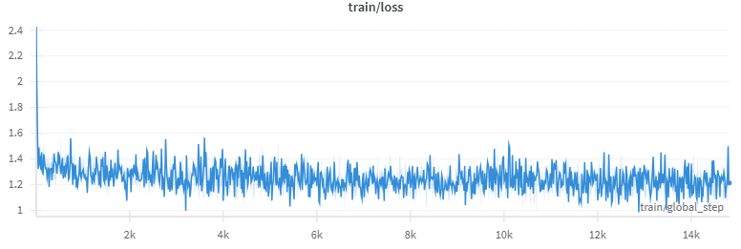
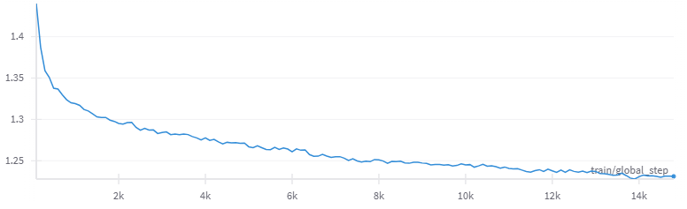
The fine-tuning ran for 8 hours with smooth evaluation loss curves
Baseline
FT
RAG
RAG + FT
Architecture Insights
Fine tuning setup
Loss curves
Training loss
training_args = TrainingArguments(
per_device_train_batch_size=1,
gradient_accumulation_steps=8,
learning_rate=2e-4,
num_train_epochs=3
)
Evaluation loss
8 hours runtime on A100

Slide 28
Averaged BLEU, ROUGE-L and Meteor scores translate to well distributed per sample distribution
Baseline
FT
RAG
RAG + FT
Research Insights
MH
Averaged scores
MH
Per sample scores for each MH test sample
0.0
0.1
0.2
0.3
0.4
0.5
BLEU
ROUGE-L
Meteor

Slide 29
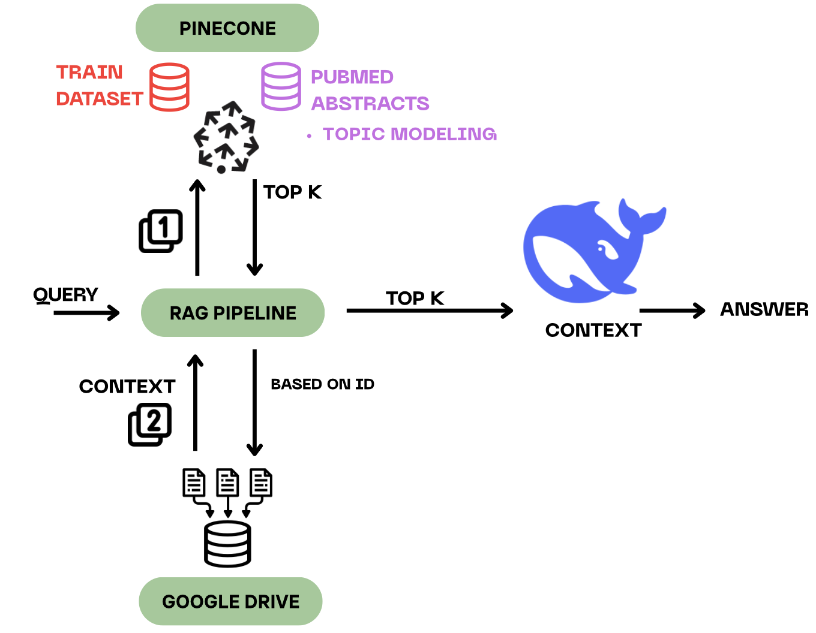
RAG
Baseline
FT
RAG
RAG + FT
Architecture Insights
Notes:
RAG besides FT?
LLM lack domain specific knowledge -> FT BUT
RAG: DYNAMIC, change,real time + CONTEXT tailored to the USER QUERY
-> promising
LANGCHAIN
Pinecone DB knowledge base
Med Q -->
RETRIEVE top k most rel. Contexts to query
AUGMENT baseline deepseek prompt with contexts
GENERATE answers
VEC DB: 2 types sources:
train strcutured questions: prepo ->vecs
PUBMED

Slide 30
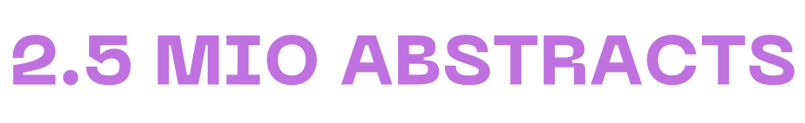
RAG
How can we effectively narrow down PubMed abstracts to a representative and diverse set ?
Baseline
FT
RAG
RAG + FT
Architecture Insights
Notes:
PUBMED:
CHALLENGE 1 data amount: 400k Q + emb alone for train in PINECONE
-> actual context / questions in google drive -> retriever gave us only ID
CHALLENGE 2 2.5 pubmed, too much -> reduce to diverse set? more difficult since not medical experts ->
SOLUTION: GLOBAL TOPIC mondeling as a strategy to find the global PUBMED topics -> sample from those topics
-> insert subset into DB

Slide 31


RAG
How can we effectively narrow down PubMed abstracts to a representative and diverse set ?
Baseline
FT
RAG
RAG + FT
Architecture Insights
randomly sampling 250 k abstracts + preprocessing
Bio_ClinicalBERT to create 50 k seed embedding → apply to 250 k abstracts
UMAP dimensionality reduction
HDBSCAN Clustering
BERTopic: 27 extracted topics
Notes:
2.5 mio abstracts -> randomly sample 250 k + preprocess -> cluster them
bioClinicalBert -> embed model for our domain
Dimensionality reduction on embeddings (UMAP)
Clustering -> used BERTopic to discover main topic structures of PUBMED
27 topics

Slide 32
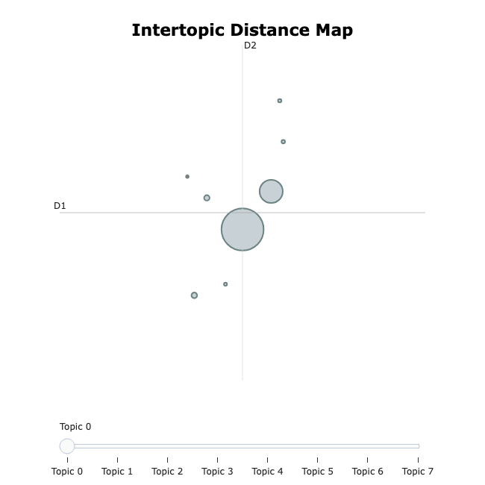
RAG
How can we effectively narrow down PubMed abstracts to a representative and diverse set ?
Baseline
FT
RAG
RAG + FT
Architecture Insights
BERTopic: 27 extracted topics​
Topic 13 | 4871 abstracts |
['patient', 'ventricular', 'coronary', 'artery', 'myocardial', 'pressure', 'report', 'disease‘]
Topic 5 | 282 abstracts |
['glucose', 'insulin', 'min', '05', 'plasma', 'diabetic', 'control', 'increase', 'group', 'subject']
Notes:
how many articles belong to each topic ?
Topic 7: bigger -> MAP
Topic 5: 280 abstracts in this topic group related to diabetes research -> small
Lets check out topics

Slide 33
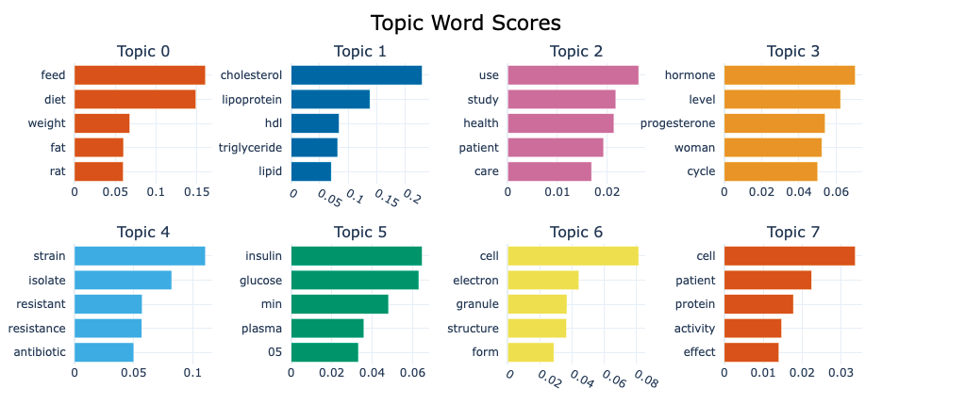
RAG
How can we effectively narrow down PubMed abstracts to a representative and diverse set ?
Baseline
FT
RAG
RAG + FT
Architecture Insights
Notes:
bar = relevance of a word to that topic based on its frequency and distinctiveness
Topic 0 = nutrition studies, keywords feed, diet, weight contribute most
Topic 3 -> hormonal health
as a non medical expert: makes sense

Slide 34
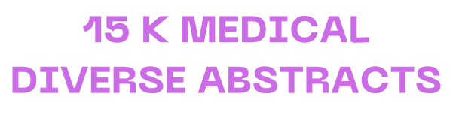
RAG
How can we effectively narrow down PubMed abstracts to a representative and diverse set ?
Baseline
FT
RAG
RAG + FT
Architecture Insights
randomly sampling 250 k abstracts + preprocessing
Bio_ClinicalBERT to create 50 k seed embedding → apply to 250 k abstracts
UMAP dimensionality reduction
HDBSCAN Clustering
BERTopic: 27 extracted topics
Balanced & high confidence filtering per topic
KeyBERT key phrase extraction → Pinecone embeddings
Notes:
From 250 k clustered abstracts sample 15 k docs from the clusters
For each of 155 k items -> not considering TM anymore
DOC LEVEL-> key phrase extraction -> PINECONE embedding

Slide 35
RAG
How can we effectively narrow down PubMed abstracts to a representative and diverse set ?
Baseline
FT
RAG
RAG + FT
Architecture Insights
Notes:
PINECONE embedding PUBMED -> filled knowledge base

Slide 36
RAG retrieves primarily documents from the same question type as the test question
Baseline
FT
RAG
RAG + FT
400k entries
11k entries
Research Insights for k = 5
Retrieved doc
MC
TF
SA
MH
PubmedQA
Total
Question
MC
5,000
3,837
134
403
626
TF
5,000
369
4,437
109
84
1
SA
2,500
677
203
1,511
107
2
MH
2,500
1,383
36
90
991
Total
6,266
4,810
2,113
1,808
3
15,000
Notes:
implemented the pipeline: monitor the entire RETRIEVAL process ?
TOTAL RETRIEVED CONTEXTS FOR EVALUATION of NAIVE RAG
Evaluation on 1000 queries / questions per type and each retrieving top 5 conteexts = total 5 k contexts
MH / SA -> smaller question set
Question ASKED -> CONTEXT RETRIEVED
With this set up = discover that RAG RETRIEVER is heavily biased towards the question type of the query
-> for MC query, retrives MC answer-> more type
!!!! less content oriented !!!
Mitigate-> pubmed -> inserted( less data) > considered in future -> might me our main RAG problem

Slide 37
Also with a balanced RAG database, RAG retrieves primarily documents from the same question type
Baseline
FT
RAG
RAG + FT
100k entries
100k entries
Research Insights for k = 5
Retrieved doc
MC
TF
SA
MH
PubmedQA
Total
Question
MC
2,500
1,979
143
669
2,135
TF
2,500
396
3,669
314
556
70
SA
5,005
429
150
1,358
499
64
MH
5,000
482
20
121
1,861
Total
3,286
3,982
2,462
5,051
224
15,005
Notes:
implemented the pipeline: monitor the entire RETRIEVAL process ?
TOTAL RETRIEVED CONTEXTS FOR EVALUATION of NAIVE RAG
Evaluation on 1000 queries / questions per type and each retrieving top 5 conteexts = total 5 k contexts
MH / SA -> smaller question set
Question ASKED -> CONTEXT RETRIEVED
With this set up = discover that RAG RETRIEVER is heavily biased towards the question type of the query
-> for MC query, retrives MC answer-> more type
!!!! less content oriented !!!
Mitigate-> pubmed -> inserted( less data) > considered in future -> might me our main RAG problem

Slide 38
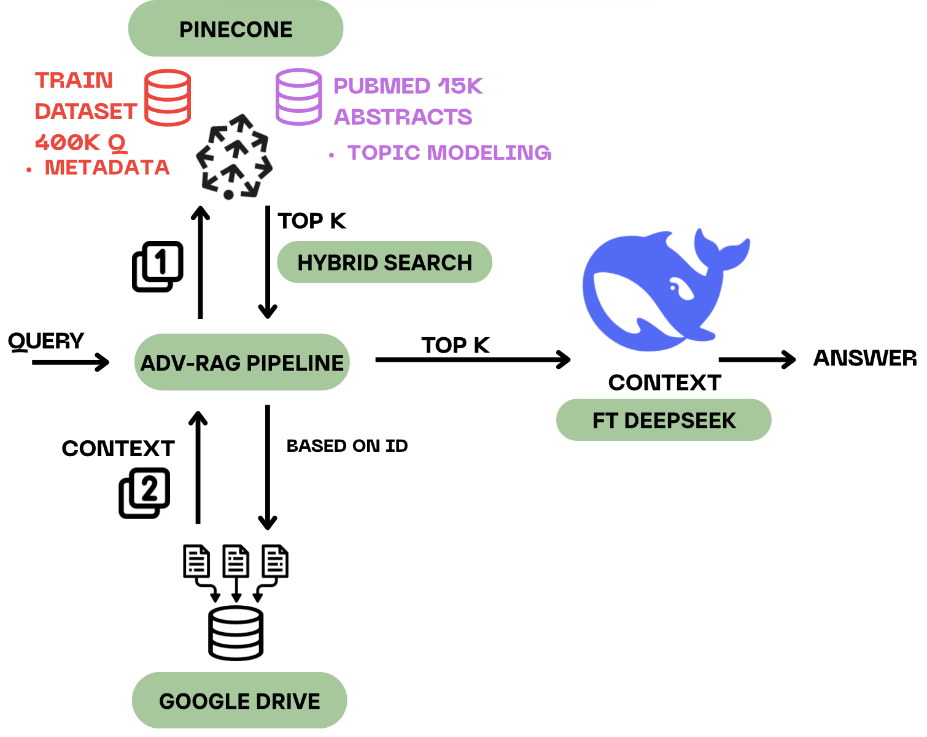

Advanced RAG + FT
Baseline
FT
RAG
RAG + FT
Architecture Insights
Notes:
ADVANCED RAG
Same set up, ENHANCEMENT retrieval component (GEN = FT)
INTERESTING inital RAG system (literature) (Lewis et al from was end to end optimized (2021) p. 5
What’s new?
Pre retrieval optimization : metadata =
Vector
metadata
Query coming in : extract same metadata
This enables hybrid search RETRIEVER

Slide 39


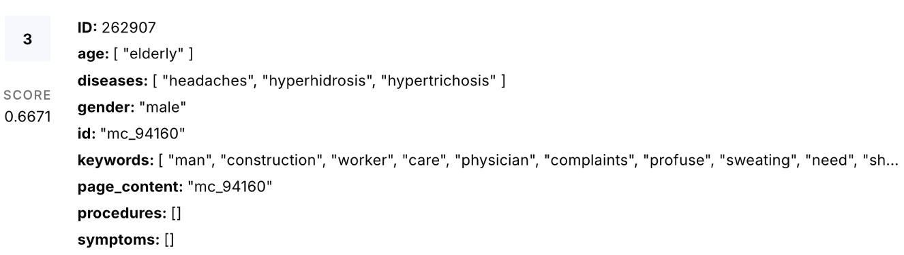
Advanced RAG + FT
Baseline
FT
RAG
RAG + FT
Architecture Insights
spaCy model en_ner_bc5cdr_md for NER on a biomedical dataset
['DISEASE', 'MEDICAL_CONDITION’, ‘SYMPTOM’, …]
Notes:
METADATA
Medical spacy MODEL for NER
-> extract disease, symptons matched
-> general age and gender of patients

Slide 40

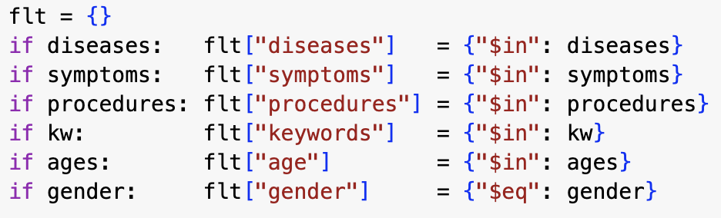
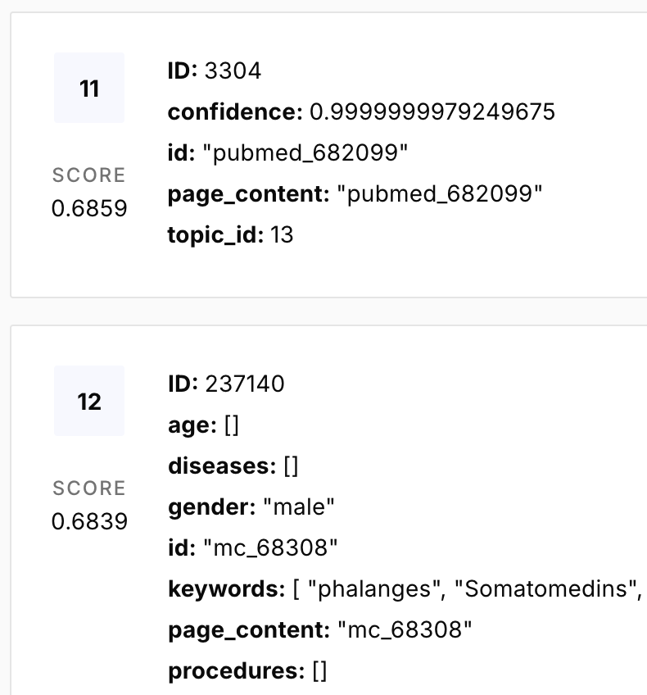
Advanced RAG + FT
Baseline
FT
RAG
RAG + FT
Architecture Insights
Combining keyword-based filtering with vector-based search…
Pinecone metadata
… to retrieve top k = 5 most relevant contexts to the query.
Notes:
HYBRID SEARCH
Combining keyword-based filtering with vector-based search…IN RETRIEVER

Slide 41
Our best approach shows high average scores but also a higher variance
Baseline
FT
RAG
RAG + FT
Research Insights
MH
Averaged scores
MH
Per sample scores for each MH test sample
0.0
0.1
0.2
0.3
0.4
0.5
0.6
0.7
0.8
0.9
1.0
BLEU
ROUGE-L
Meteor
Notes:
RESULTS : one highlight combining FT deepseek + advanced RAG = highest performance increase for MH questions but when
Check out distirbution of sample scores -> higher variance -> PERFORMANCE SPREAD
RAG adds more information — but not always the right information,
MH (multi-hop) questions are especially sensitive to context quality
-> TO DO: evaluate retrieved context quality to investigate there
BLEU PREC
ROUGE: REC

Slide 42
With these metrics we can evaluate all question types and approaches separately
Overview of performances per question type and approach
Baseline
FT
RAG
RAG + FT
MC
Acc: 0.254
19 min L4
Acc: 0.404
15 min A100
Acc: 0.337
15 min A100
Acc: 0.467
18min A100
TF
Acc: 0.477
19 min L4
Acc: 0.655
15min A100
Acc: 0.437
14 min A100
Acc: 0.595
30min A100
SA
ROUGE-L: 0.06
35min L4
ROUGE-L: 0.18
74min A100
ROUGE-L: 0.26
37min A100
ROUGE-L: 0.35
40min A100
MH
ROUGE-L: 0.07
56min L4
ROUGE-L: 0.24
10min A100
ROUGE-L: 0.29
56min A100
ROUGE-L: 0.40
77min A100
Notes:
GLOBALPERFORMANCE BOARD -> monitored generation time + instances
tried to perform an ablation study systematically adding components -> assess individual impact
Fine-tuned DeepSeek
Especially strong on MC and TF questions, Outperforms both baseline and naive RAG in these tasks
Naive RAG on baseline DS :
added value of retrieving supporting evidence for open-ended generation tasks, even without fine-tuning (SA, MH)
WINNER : RAG + FT consistently performs best across the board ->
best of both worlds
open-ended SA, MH -> ROUGE- 0.07 to 0.40 for MH
> combining quality retrieval with domain specific fine-tuning for the generation component.

Slide 43
With these metrics we can evaluate all question types and approaches separately (balanced RAG added)
Overview of performances per question type and approach
Baseline
FT
RAG
RAG + FT
Balanced RAG + FT
MC
Acc: 0.254
19 min L4
Acc: 0.404
15 min A100
Acc: 0.337
15 min A100
Acc: 0.467
18min A100
Acc: 0.422
15min A100
TF
Acc: 0.477
19 min L4
Acc: 0.655
15min A100
Acc: 0.437
14 min A100
Acc: 0.595
30min A100
Acc: 0.573
32min A100
SA
ROUGE-L: 0.06
35min L4
ROUGE-L: 0.18
74min A100
ROUGE-L: 0.26
37min A100
ROUGE-L: 0.35
40min A100
ROUGE-L: 0. 28
43min A100
MH
ROUGE-L: 0.07
56min L4
ROUGE-L: 0.24
10min A100
ROUGE-L: 0.29
56min A100
ROUGE-L: 0.40
77min A100
ROUGE-L: 0.22
73min A100
Notes:
GLOBALPERFORMANCE BOARD -> monitored generation time + instances
tried to perform an ablation study systematically adding components -> assess individual impact
Fine-tuned DeepSeek
Especially strong on MC and TF questions, Outperforms both baseline and naive RAG in these tasks
Naive RAG on baseline DS :
added value of retrieving supporting evidence for open-ended generation tasks, even without fine-tuning (SA, MH)
WINNER : RAG + FT consistently performs best across the board ->
best of both worlds
open-ended SA, MH -> ROUGE- 0.07 to 0.40 for MH
> combining quality retrieval with domain specific fine-tuning for the generation component.

Slide 44
Agenda
1
Introduction of the ClinIQ challenge
@Adria bild ersetzen
2
Our approach to solve the challenge
3
Data gathered for training and testing
4
Scores leveraged for evaluation
Agenda
5
Agenda
Models + Results for our different approaches
Baseline Fine-Tuning (FT)
Retrieval Augmented Generation (RAG)
FT + RAG
6
Final remarks and next steps

Slide 45




Final Remarks & Next Steps
Diverse, domain-specific datasets & preprocessing
Comprehensive Evaluation Suite & Performance tracking
Improved performance for all our question types
Advanced RAG Reranking strategies
Exploring Agentic RAG → different medical specialists
Evaluate and experiment with additional model variants and architectures
Notes:
Proud : improved on all question types and established a comprehensive evaluaton suite
Future extensions : RAG :
post retrieval strategies : reranking of contexts
Agentic RAG promsing, our task> : implement different medical specialists : dietitian, caridologist
Experimenting with model variants & architectures

Slide 46
For risks and side effects, ask your doctor or our ClinIQ.
Natural Language Processing with Large Language Models
Lorena Raichle, Adria Pop, Konstantin Wehmeyer
May 20, 2025
46

Slide 47
Sources
Neuhaus, Dominik. (20.09.2024). „Schweizer Medizinstudis flüchten vor Numerus clausus nach Osteuropa.“, Nau.ch, https://www.nau.ch/news/europa/schweizer-medizinstudis-fluchten-vor-numerus-clausus-nach-osteuropa-66831473
ClinIQLink 2025 - LLM Lie Detector Test. (n.d). Evaluation Metrics. Retrieved from: https://cliniqlink.org/
Lemesle, Q., Chevelu, J., Martin, P., Lolive, D., Delhay, A., & Barbot, N. (2025, January). Paraphrase Generation Evaluation Powered by an LLM: A Semantic Metric, Not a Lexical One. In Proceedings of the 31st International Conference on Computational Linguistics (pp. 8057-8087).
Chiusano, F. (2022). Two minutes NLP — Learn the ROUGE metric by examples ROUGE-N, ROUGE-L, ROUGE-S, pros and cons, and ROUGE vs BLEU. Retrieved From: https://medium.com/nlplanet/two-minutes-nlp-learn-the-rouge-metric-by-examples-f179cc285499
Liu, Y., Iter, D., Xu, Y., Wang, S., Xu, R., & Zhu, C. (2023). G-eval: NLG evaluation using gpt-4 with better human alignment. arXiv preprint arXiv:2303.16634.
Jan Wira Gotama Putra and Takenobu Tokunaga. 2017. Evaluating text coherence based on semantic similarity graph. In Proceedings of TextGraphs-11: the Workshop on Graph-based Methods for Natural Language Processing, pages 76–85, Vancouver, Canada. Association for Computational Linguistics.

Slide 48
Sources - Figures
ClinIQLink. (n.d.). ClinIQLink 2025 – LLM Lie Detector Test [Figure]. Retrieved from https://cliniqlink.org/
Wikipedia contributors.(n.d). Pubmed. [Figure]. Retrieved From: https://de.wikipedia.org/wiki/PubMed
Wikipedia contributors.(n.d). Deepseek [Figure]. Retrieved From:https://en.m.wikipedia.org/wiki/File:DeepSeek_logo.svg
PR Newswire. (2024). Pinecone Makes Accurate, Fast, Scalable Generative AI Accessible to Organizations Large and Small with Launch of its Serverless Vector Database. [Figure]. Retrieved From: https://www.prnewswire.com/news-releases/pinecone-makes-accurate-fast-scalable-generative-ai-accessible-to-organizations-large-and-small-with-launch-of-its-serverless-vector-database-302151425.html

